Slide 1

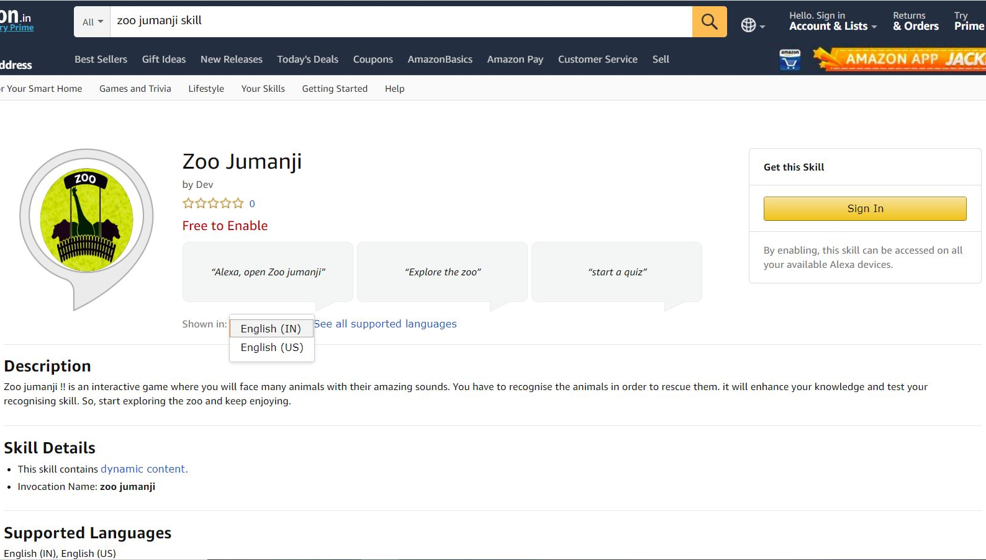

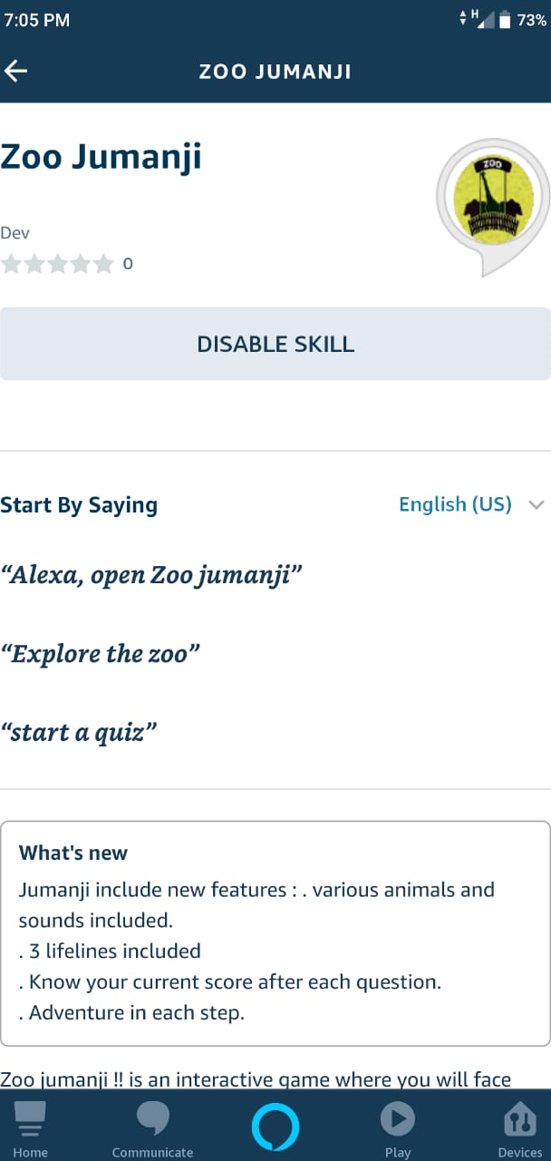
Stay Fit
Problem statement and
solution proposal

Slide 2
Outline
The Problem
What customers do today
Use cases
About the skill
Instructions
Overview
Why it's better than existing solutions
About the team
References

Slide 3
The Problem

Slide 4
Problem statement
Game ideas for people of age group 25-40 A 25-40 year old woman, or man, who doesn't like exercising, and your interesting game can motivate them to exercise to earn points, compete against their others on leader-boards etc.
Build an Alexa game that helps consumers to learn
get in shape (gamify fitness).

Slide 5
What customers do today

Slide 6
What customers do today
Build Alexa for people of age group 25-40 for interaction.
Now a days, People around 25-40 year old woman, or man, who doesn't like to do exercise.
Major reason behind this issue is that due to lack of awareness about the exercise and fitness. They have to be health conscious in a right way.

Slide 7
Use cases

Slide 8
Use cases
Learn something new daily from game about healthy diet.
Used for tracking your fitness.
Try simple exercise at home with fun.
Compete on the basis of your knowledge and fitness.
Enjoy the virtual fitness hub experience and stay engaged.

Slide 9
About the Skill

Slide 10
Alexa Skill (Stay Fit)
Stay Fit is an interactive alexa game skill. You will get experience of fitness hub with various knowledge about health and proper diet.
It’s a kind of quiz game that let the people to know about various exercises and diet.
People can find their scores on the leaderboard and compete among themselves.
Score on the leaderboard are calculated on the basis of correct answers and BMI(Body Mass Index) .So that user can track their fitness as well .
This skill involve different questions related to exercise, balanced diet and health issues along with countdown timer for performing exercise.

Slide 11
Instructions

Slide 12

How to play (Stay Fit)
Stay Fit is an alexa fitness skill game. You will get experience of fitness hub with various tips and facts.
First of all you need to enable the skill .There are two languages to interact with ( EN-US ) , ( EN-IN ).
Say “ Alexa start Stay Fit ” to start the game.
Users are asked to provide their name, gender , age , height and weight to continue the game.
You just need to say "Explore the hub" to start exploring the fitness hub through a quiz game .
In that quiz you got asked 5 question .In each question you need to answer carefully otherwise you will be assigned a exercise and need to perform that in 10 seconds along with the timer countdown.
You have only 5 lifelines to save the hub, means you are not allowed to play more after giving 5 wrong answers.
You can ask for help in any state of the game if u dont know what to do next & after the help you can continue your game.
You can quit the game anytime by saying "Exit".
At the end of the game you will get your score on the leaderboard on the basis of quiz and fitness.
We recommend you to play on ( EN-US ) language to get the best virtual environment sound effects.

Slide 13
Overview

Slide 14
Alexa Skill (Stay Fit)
Stay Fit is an alexa fitness skill game. You will get experience of fitness hub with various tips and facts.
In stay fit you can enjoy your time with your friend circles by competing them via leader board.
It’s a funful game for people belonging to the age group between 25-40 engaged with exercise.
At the end of the game user will get score on the basis of quiz played and on their fitness.
Here user can aware about their fitness based upon BMI( Body Mass Index).So, they can track their fitness also via playing a simple game.

Slide 15
Why it's better than existing solutions

Slide 16
Why it’s better than existing solutions
In a comparison to other existing solutions this skill has following features:
Various Sound effects which leads to a virtual environment.
User can easily track their fitness through using the skill.
Various new fun facts, question added related to health and diet.
User can update their weight , height easily.
Timer or Countdown is added for performing the exercise.
Leader board will help users to compete each other.
It’s consist of very few question in a session so that user won’t feel bored.

Slide 17


About the team : ( DEV_WARRIOR )
VED PRAKASH SUMAN DEBASHISH PATRA

Slide 18
References
Alexa skill ID : amzn1.ask.skill.56d0b861-214d-4bfd-b683-a7269da67f5f
Your vendor ID : M17EPYZRQA6BF6
Skill store(US) : https://www.amazon.com/dp/B084DVPZG4
Skill store(IN) : https://www.amazon.in/dp/B084DVPZG4
GitHUb link : https://github.com/vedprakashsuman777/Zoo-Jumanji
Youtube : https://youtu.be/_bBzhuGMa6c

